Slide 1
LUC 5
Economic Analysis

Slide 2
Economic Analysis
Cost estimates
acquisition or development costs
operation and maintenance costs
Benefit estimates
tangible benefits
intangible benefits

Slide 3
The Steps
Scoping—understand the problem and the work that must be done
Estimation—how much effort? how much time?
Risk—what can go wrong? how can we avoid it? what can we do about it?
Schedule—how do we allocate resources along the timeline? what are the milestones?
Control strategy—how do we control quality? how do we control change?

Slide 4
Write it Down!
Project Scope
Estimates
Risks
Schedule
Control strategy
Software
Project
Plan

Slide 5
To Understand Scope ...
Understand the customers needs
understand the business context
understand the project boundaries
understand the customer’s motivation
understand the likely paths for change
understand that ...
Even when you understand,
nothing is guaranteed!

Slide 6
Cost Estimation
project scope must be explicitly
defined
task and/or functional
decomposition is necessary
at least two different techniques
should be used
remember that uncertainty is
inherent
historical measures (metrics) are
very helpful

Slide 7
Estimation Techniques
past (similar) project experience
conventional estimation techniques
task breakdown and effort estimates
size (e.g., FP) estimates
tools (e.g., Checkpoint)

Slide 8
Functional Decomposition
functional
decomposition
Statement
perform
of Scope
a
"grammatical
parse"

Slide 9
Creating a Task Matrix
Obtained from “process framework”
framework activities
application
functions
Effort required to accomplish
each framework activity for each application function

Slide 10
Conventional and traditional Methods: LOC/FP Approach
compute LOC/FP using estimates of information domain values
use historical effort for the project

Slide 11
Example: LOC Approach

Slide 12
Example: FP Approach

Slide 13
Tool-Based Estimation
project characteristics
calibration factors
LOC/FP data

Slide 14
Empirical Estimation Models
General form:
effort = tuning coefficient * size
exponent
usually derived
as person-months
empirically
of effort required
derived
usually LOC but
may also be
either a constant or
function point
a number derived based
on complexity of project

Slide 15
Estimation Guidelines
estimate using at least two techniques
get estimates from independent sources
avoid over-optimism, assume difficulties
you've arrived at an estimate, sleep on it
adjust for the people who'll be doing the
job—they have the highest impact

Slide 16
The Make-Buy Decision

Slide 17
Computing Expected Cost
expected cost =
(path probability) x (estimated path cost)
i
i
For example, the expected cost to build is:
expected cost = 0.30($380K)+0.70($450K)
build
= $429 K
expected cost = $382K
reuse
similarly,
expected cost = $267K
buy
expected cost = $410K
contr

Slide 18
Estimating Costs
acquisition or development (one time)
operation and support (ongoing)
in these expense categories
personnel hours
computer usage
media and supplies
equipment and software

Slide 19
Estimating Development Cost
break project up into tasks
estimate SDLC tasks independently
use life cycle cost model
e.g., 1-3-3-3 model
take advantage of analogy/experience
how much have similar projects cost?
calculate function point metric
estimate “size” of project from inputs, outputs, etc.
apply productivity rate

Slide 20
Estimating Operation and Support
client/user personnel
technical personnel
media and supplies
equipment and software support
repair
enhancement

Slide 21
Estimating Tangible /touchable Benefits
reduced costs
manual operations
computer operations
programmed decisions
increased revenue
new services
differentiated product
faster delivery
better quality
larger market share

Slide 22
Estimating Intangible Benefits
information quality
precision
timeliness
integration
presentation
job satisfaction
participative design
job enrichment
improved tools
external standing
responsiveness
corporate image

Slide 23
Economic Analysis (continued)
traditional capital planning techniques apply
payback analysis
return on investment
net present value

Slide 24
LUC 6
payback analysis

Slide 25
Payback Analysis
_{January 1996}
determines how long it will take for accrued benefits to overtake accrued and continuing costs
most companies want quick payback
3-5 years is typical

Slide 26
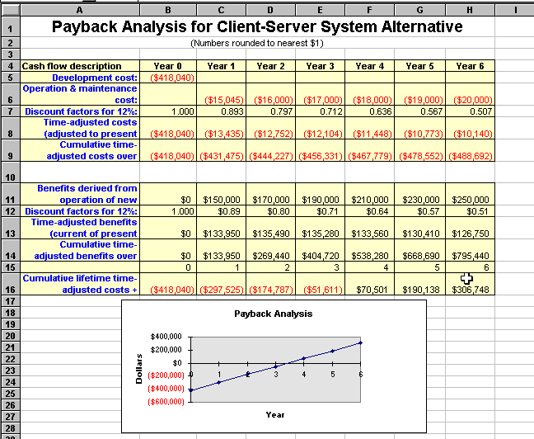

Slide 27
Computing the payback period
Can compute the break-even point:
when does lifetime benefits overtake lifetime costs?
Determine the fraction of a year when payback actually occurs:
| beginningYear amount |
endYear amount + | beginningYear amount |
For our last example, 51,611 / (70,501 + 51,611) = 0.42
Therefore, the payback period is approx 3.4 years

Slide 28
Schedule Feasibility
How long will it take to get the technical expertise?
We may have the technology, but that doesn't mean we have the skills required to properly apply that technology.
May need to hire/ renting new people
Or re-train existing systems staff
Whether hiring or training, it will impact the schedule.
Assess the schedule risk:
Given our technical expertise, are the project deadlines reasonable?
If there are specific deadlines, are they mandatory or desirable?
If the deadlines are not mandatory, the analyst can propose several alternative schedules.

Slide 29
What are the real constraints on project deadlines?
If the project overruns/exceed, what are the consequences?
Deliver a properly functioning information system two months late…
…or deliver an error-prone, useless information system on time?
Missed schedules are bad, but inadequate or insufficient systems are worse!

Slide 30
Operational Feasibility
How do end-users and managers feel about…
…the problem you identified?
…the alternative solutions you are exploring?
You must evaluate:
Not just whether a system can work… but also whether a system will work.
Any solution might meet with resistance:
Does management support the project?
How do the end users feel about their role in the new system?
Which users or managers may resist (or not use) the system?
How will the working environment of the end users change?
Can or will end users and management adapt to the change?

Slide 31
Feasibility Study Contents
Purpose & scope of the study
Objectives (of the study)
who commissioned it & who did it,
sources of information,
process used for the study,
how long did it take,…
Description of present situation
organizational setting, current system(s).
Related factors and constraints.
Problems and requirements
What’s wrong with the present situation?
What changes are needed?
Objectives of the new system.
Goals and relationships between them
Possible alternatives
…including ‘do nothing’.
Criteria for comparison
definition of the criteria
Analysis of alternatives
description of each alternative
evaluation with respect to criteria
cost/benefit analysis and special implications.
Recommendations
what is recommended and implications
what to do next;
E.g. may recommend an interim solution and a permanent solution
Appendices
to include any supporting material.

Slide 32
Comparing Alternatives
How do we compare alternatives?
When there are multiple selection criteria?
When none of the alternatives is superior across the board?
Use a Feasibility Analysis Matrix!
The columns correspond to the candidate solutions;
The rows correspond to the feasibility criteria;
The cells contain the feasibility assessment notes for each candidate;
Each row can be assigned a rank or score for each criterion
e.g., for operational feasibility, candidates can be ranked 1, 2, 3, etc.
A final ranking or score is recorded in the last row.
Other evaluation criteria to include in the matrix
quality of output
ease of use
vendor support
cost of maintenance
load on system

Slide 33
Example matrix

